Slide 1









INCOMPLETE

Slide 2
Meet The TEam
Владислав Кършаков – Scrum Trainer
Мартин Кафеджиев– Backend Developer
Галин Атанасов– Backend Developer
Георги Димов– QA

Slide 3
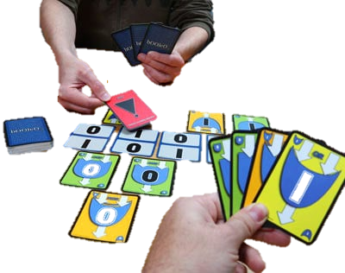
Purpose of the Project
The purpose of the project was to recreate the card game booleo. The game is not made anymore and with this project we planned to keep it alive.

Slide 4


Future Ideas
We have a lot of ideas for the future. One of them is to finish the project, when we are sure that we have the skill to do so. Other plans include using different more complicated technologies like openGL

Slide 5






Technologies Used

Slide 6

Cards and Background design

Slide 7
Thanks for your attention

